Slide 1
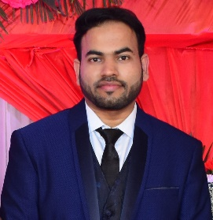
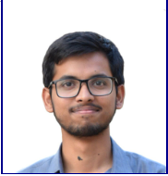
<Work-let Area – Quantum Safe Cryptography> | < Deployment of Quantum Safe Crypto algorithms in Android>
Problem Statement
As quantum computing is getting more accessible to users, it creates alarm for cryptographic use cases if it gets misused by attackers. So many improvements / enhancements being done to make crypto algorithms quantum resistant.
NIST has selected some of the crypto algorithms based on their selection criteria.
We need to bring up those algorithms in Android ecosystem.
Additional Information
https://openquantumsafe.org/
https://pqca.org/
https://github.com/open-quantum-safe/liboqs/
Work-let expected duration – 3 months
Expectations
Explore open source library that provides quantum safe algorism.
Build native shared library for Android platform (ARM-v8a)
Integrate native library with Android Application.
Develop use case using Standard crypto graphic algorithm and quantum safe algorithm.
Sign / Verify
Sharing shared Secret
Prepare comparison report on timing , CPU , Memory consumption (Standard vs Quantum safe algorithms)
Provide theoretical analysis how NIST selected algorithms justify post quantum resistance.
Training/ Pre-requisites
Sound knowledge on Cryptography algorithms.
Hands on with native library development and cross compilation.
Android App (kotlin) Development
2
Members
Project Timeline
Contact Point:
Milestone 1 < 1st Month >
Explore Crypto Algorithms selected by NIST for post quantum requirements.
Explore open source library for the algorithm implementations.
Milestone 2 < 2nd Month >
Select open source library.
Build and validate algorithms in PC.
Cross compile and build shared library for Android.
Develop Android app and integrate the library.
Closure < 3rd Month >
Develop secure key sharing and sign/verify use case using standard algorithm and quantum safe algorithm.
Prepare and share comparison report and Analysis Report.
Kick Off Meeting
Problem Statement shared and discussed
Rajesh Kumar Panda
Senior Chief Engineer
rajesh.p9@samsung.com
+91-7827545253
Bipin Jadav
Engineer
bipin.jadav@samsung.com
+91-7567739101

